Slide 1
Automatic Lens Smear Detection
Home Work 1

Slide 2
Team MEMBERS
Adarsh M V – A20424847
Prerna Kumari – A20428292
Harshitha Rangaswamy – A20400223
Rahul Hosmani – A20418527

Slide 3
Problem Statement
To detect smears in the sequence of street view images.
Input: A sequence of street view images
Output: A mask of the smear on the lens

Slide 4
Environment
Programming language: Python version 3.7.2
Packages Used:
NumPy version 1.16.0
OpenCV version 4.0.0
Glob
Random
Sys

Slide 5
Algorithm for Smear Detection
Step 1 : Resizing images from 2032 x 2032 to 500 x 500
Step 2: Using Gaussian Filter on the resized image
Step 3: Averaging the images
Step 4: Converting the mean image to grayscale
Step 5: Finding the Threshold using built-in adaptive threshold method
Step 6: Finding the invert of the image which will act as a mask
Step 7: Finding Contours on the masked image
Step 8: Checking if the contours on the image have the characteristics a smear.
Assumption: We assume that a smear has the area greater than 314 and smaller than 452.16 sq. pixels
Step 8.a: If found than the images contain a smear. And the Smear is masked and it is saved.
Step 8.b: If nothing is found than there is no smear on the lens.

Slide 6
Gaussian Blur (Smoothing)
The gaussian kernel is used with a size of 3 x 3. The filter size should be specified as positive and odd.
Gaussian blur is the result of blurring the image by a Function.
It is used to reduce the image noise and detail.
It is typically used as a preprocessing stage in computer vision algorithms.

Slide 7
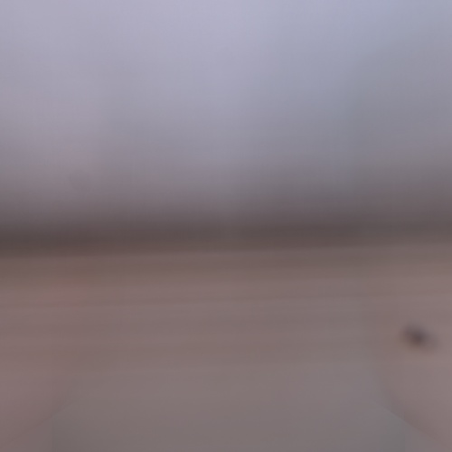
Averaging the images of each camera
For finding the average image, we add all the images, which highlights the common areas of the image and divide by the total number of images.
Example of Averaged image after Gaussian blur on each image from different camera angles.

Slide 8
Converting Mean Image to Grayscale
The images are converted from RGB to Grayscale

Slide 9
Adaptive Gaussian Threshold
Adaptive gaussian thresholding is used, to counter act the different lighting conditions in the images
The threshold is the weighted sum of the neighborhood values.
Weights are the gaussian window.
It helps in smoothing the image.

Slide 10
Contour Detection
Contours are the summation of all the continuous points on the edges with the same color.
To find the contours on the image, findContours method of open CV is used.

Slide 11
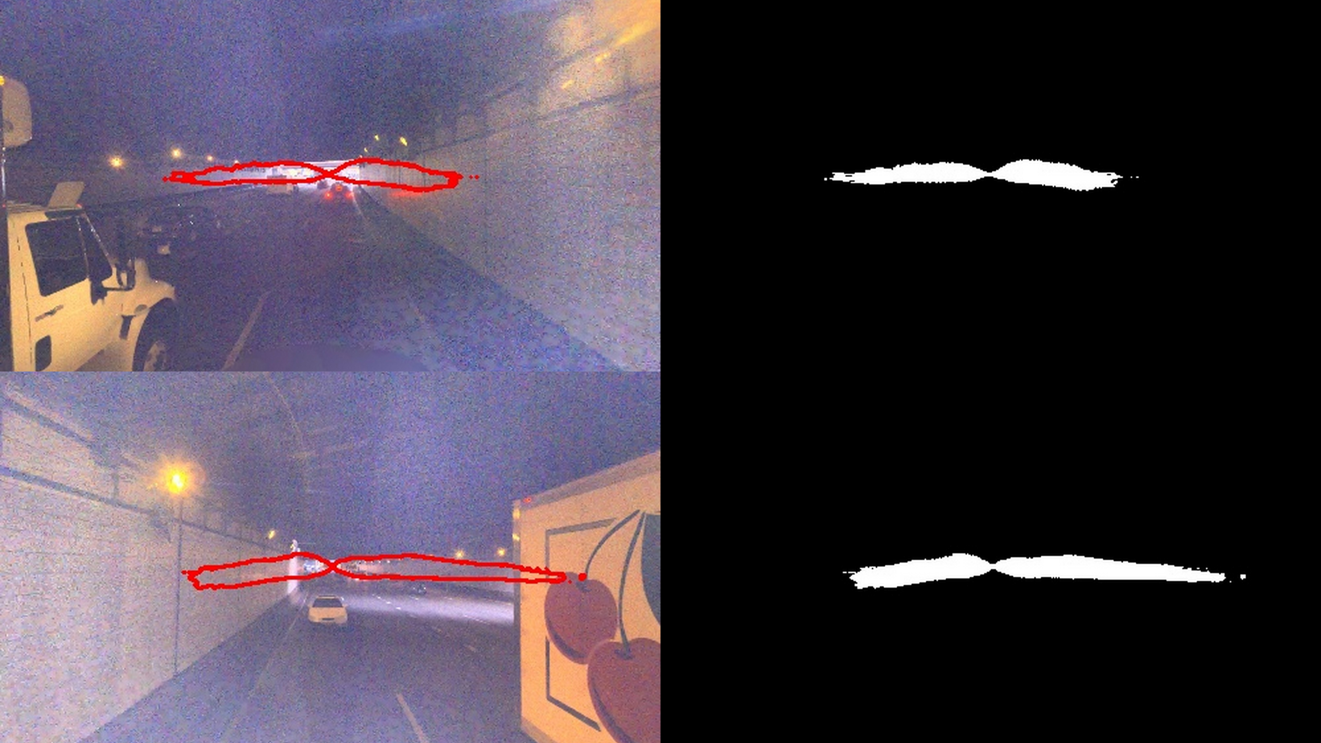
Drawing Contours
OpenCV provides drawContours method to draw the contours.
Examples of drawn contours.
Intermediate Results when the Smear characteristics are not set.

Slide 12
Setting smear characteristics
Assumption:
We assume that a smear has the area greater than 314 and smaller than 452.16 sq. pixels, That is
The minimum radius is 10 pixels
The maximum radius is 12 pixels
We consider that if the contour lies within these boundaries it is characterized as a smear on the image.

Slide 13
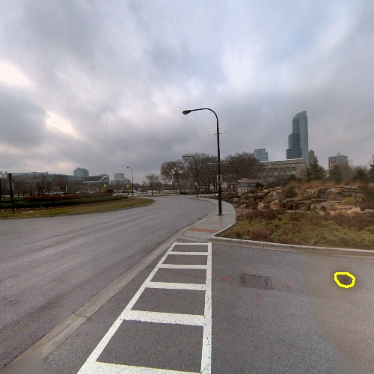
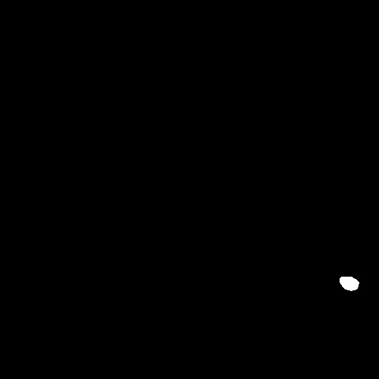
Final output image in camera 3
The image is masked such that the smear is visible.

Slide 14
References
https://docs.opencv.org/3.0-beta/doc/py_tutorials/py_tutorials.html
https://docs.opencv.org/4.0.0/d4/d73/tutorial_py_contours_begin.html
“An algorithm of removing highlight target's smear in space observation image” - Author(s) Jian Zhang ; Liansheng Wang ; Jiancun Ren

